Slide 1
Bitcoin Closing Rate Forecasting – Machine Learning Project
Mor Yossef & Rinat Polonski
github.com

Slide 2
Bitcoin
Bitcoin is a decentralized digital currency, without a central bank or single administrator, that can be sent from user to user on the peer-to-peer bitcoin network without the need for intermediaries.
The cryptocurrency was invented in 2008 by an unknown person or group of people. The currency began to use in 2009 when its implementation was released as open-source software.
Today bitcoin is one of the most popular digital currency in the world.
Our research question is trying to predict the future rate of Bitcoin currency based on multiple parameters span over the years.
Research Question

Slide 3
Project’s Main Steps
Data-Acquisition
Web crawling and API for collecting and obtaining the data
Data Cleaning
Cleaning, formatting, and filtering the data.
EDA
Machine Learning
Visualizing and understanding the data
Create final predict model

Slide 4
Data Sources
API
Google Trends
Twitter’s Tweets
Crawling (selenium)
https://nomics.com/assets/btc-bitcoin/history

Slide 5

Selenium
Selenium is an open-source project for a range of tools and libraries aimed at supporting web browser automation. Selenium provides a playback tool for authoring functional tests without the need to learn a test scripting language .
It supports provides all popular programming languages: including JavaScript, C#, Groovy, Java, Perl, PHP, Python.
The tests can then run against most modern web browsers.
Selenium runs on Windows, Linux, and macOS. It is open-source software released under the Apache License 2.0.
We used in our project python and chrome browser.

Slide 6
Crawling
Using Selenium we performed the crawling stage on the site.
The site keeps data about Bitcoin and other well-known coins history.
We took the relevant columns for our project : DATE, OPEN, HIGH, LOW, CLOSE, VOLUME.
The data begin in 2011 until today.
Finally, the records are saved into CSV to work with dataset.

Slide 7
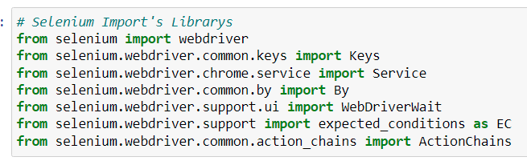
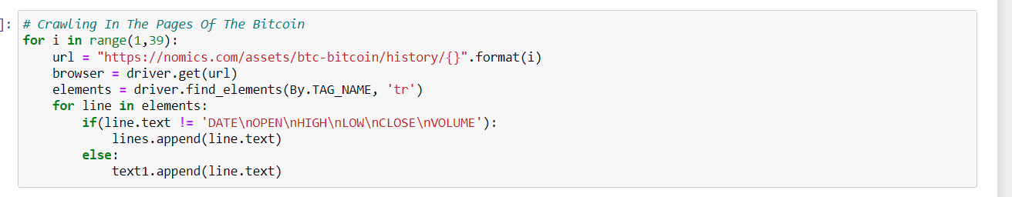
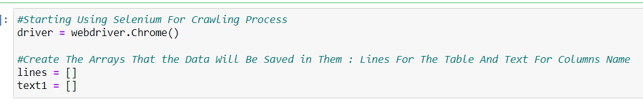
Crawling

Slide 8
Not Everything Was So Easy…
At the beginning we tried using ‘Beautiful Soup’ library but we couldn’t get the relevant data because we were dealing with dynamic websites.
We looked for different crawling tools which can deal with dynamic sites. After Research, we decided to use selenium instated.

Slide 9
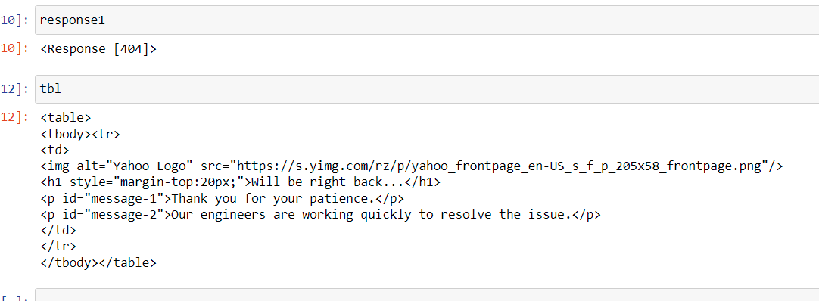
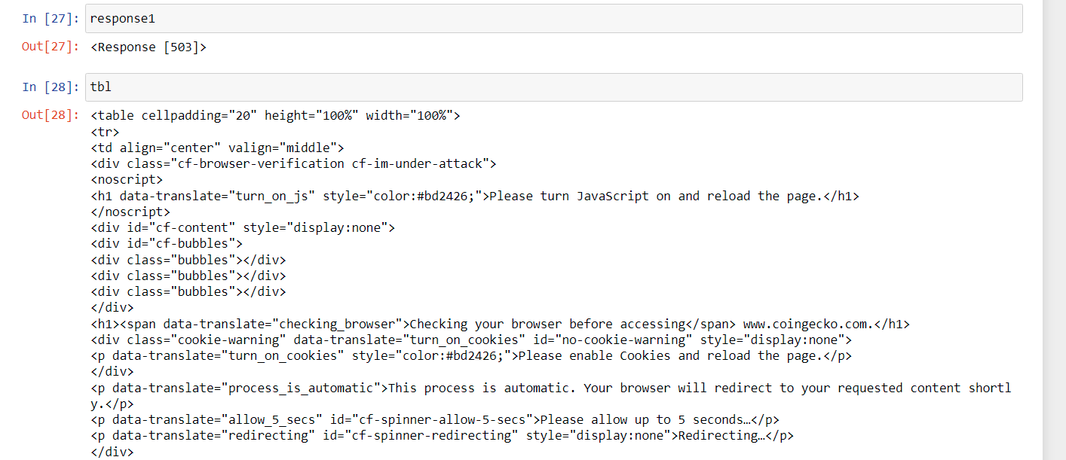

Slide 10
Twitter API + Google Trends
We knew there is a connection between the number of tweets from Twitter and Google trends about the rate of the bitcoin.
For example: Elon Musk announced that Tesla bought bitcoins worth $1.5 billion, the cryptocurrency rose by 20 percent in one day.
So we decided to add those parameters to our data.

Slide 11
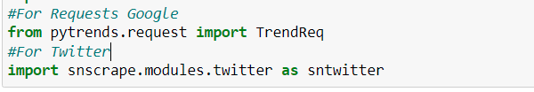
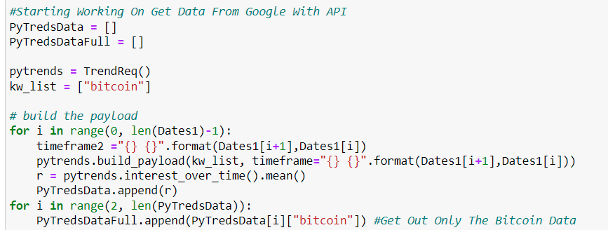
The Libraries We Used:
Google-API

Slide 12
TextBlob
TextBlob is a Python library for processing textual data. It provides a simple API for diving into common natural language processing (NLP) tasks such as part-of-speech tagging, noun phrase extraction, sentiment analysis, classification, translation, and more.
We used this tool to classify the tweets in each date to positive and negative.

Slide 13
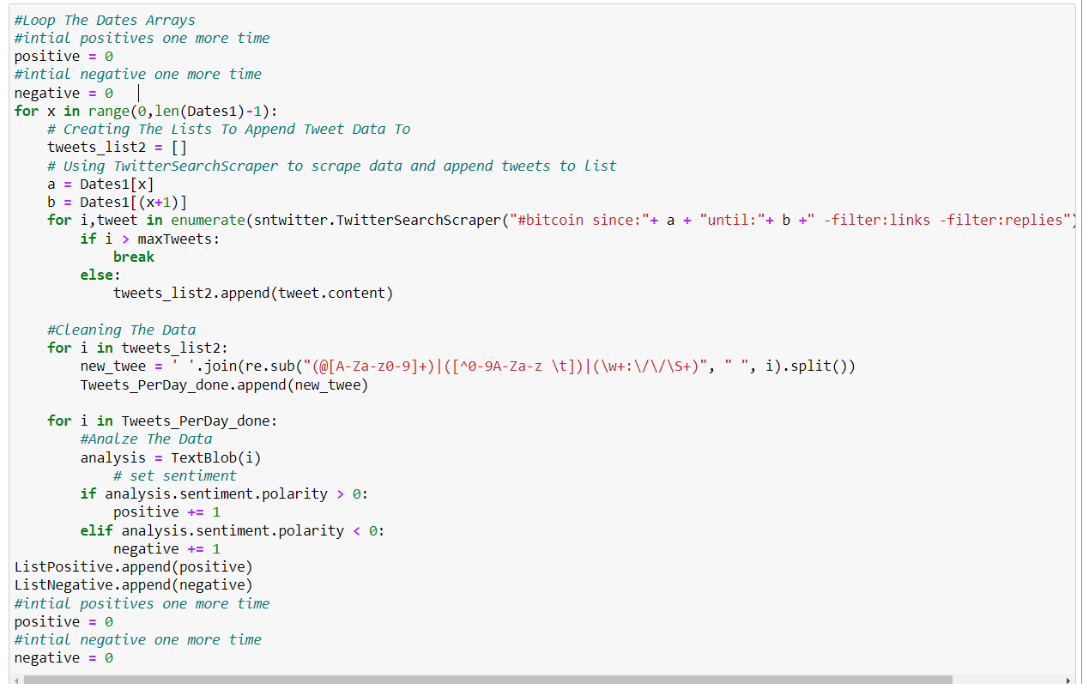
Twitter API
Search Tweets
Clean The Tweets
Using re Library
TextBlob Classification

Slide 14
Cleaning The Data
“Up|Down” – We converted the categorical column to binary parameter.
Change (%) – We added percent column for the changing in the closing rate column.
Date – We changed the original dates we got from the site to the same twitter format.
Outliers – Our data is based on time series so we are looking for outliers using %.
Null – Search for missing data.
Cleaning – We deleted columns which didn’t help for the machine Learning stages.

Slide 15
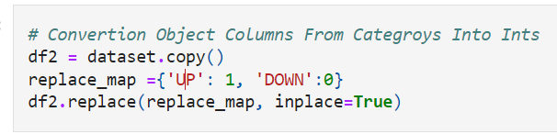
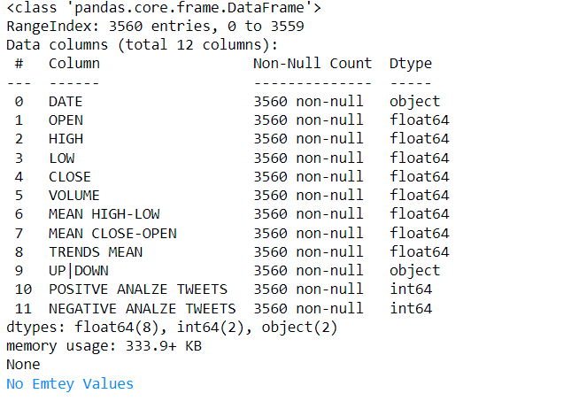
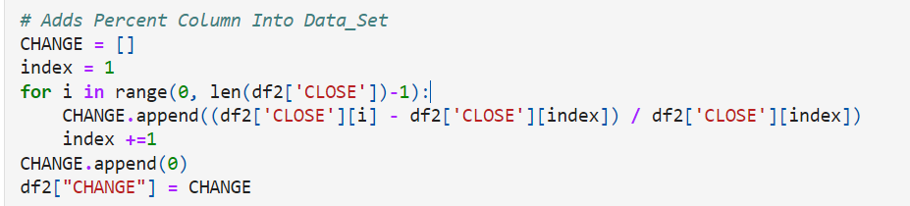
Category Column Into 0/1
Missing Cells
Add Percent (%)

Slide 16
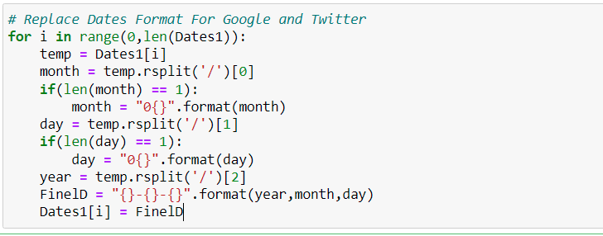
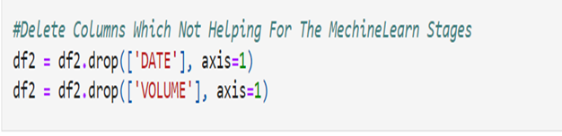
Date Formatting
Delete Columns

Slide 17
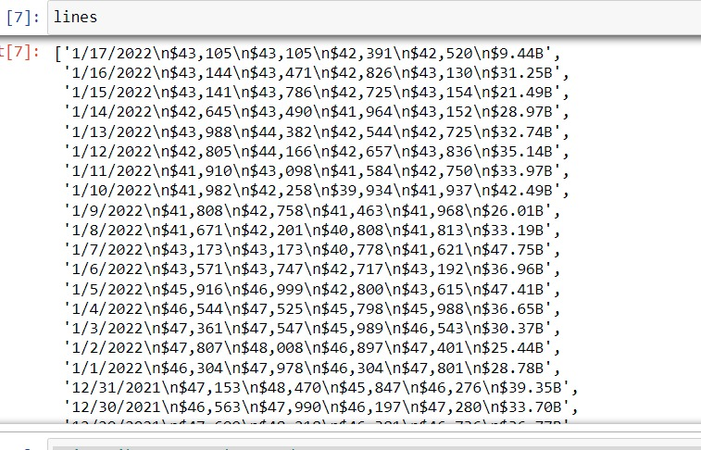
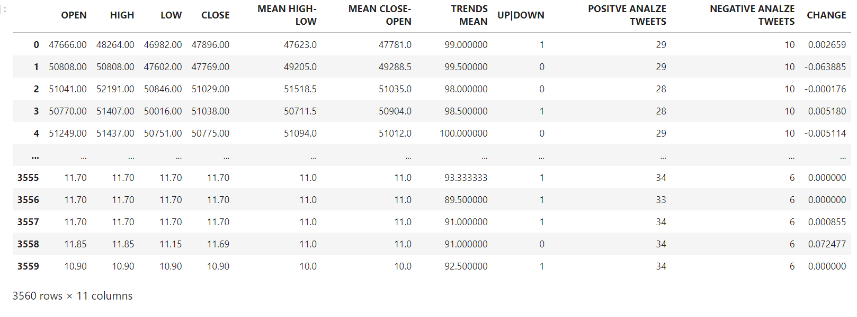
Cleaning The Columns
After Cleaning Dates & Volume

Slide 18
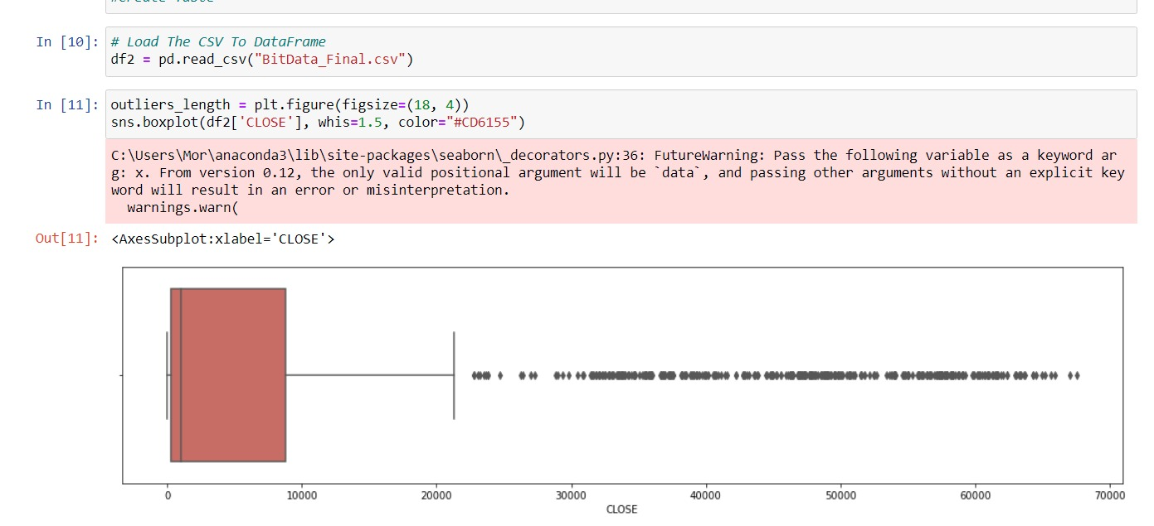
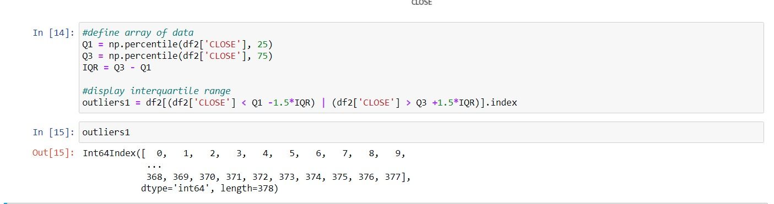
Working With Outliers – Problem

Slide 19
Outliers – Dropping
We realized cleaning outliers from the close column is not necessary in time series dataset.
We still wanted to clean columns which contains high values that can hurt our prediction. So we decided to look at the change % in “Close” column.
We used IQR method to clean the outliers with Whisker = 1.5.
In the end we dropped the outliers from the dataframe.

Slide 20
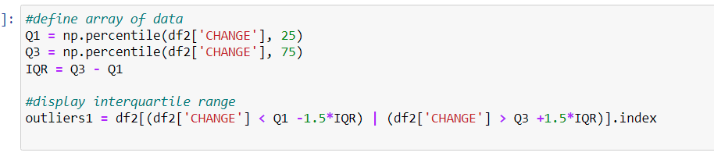
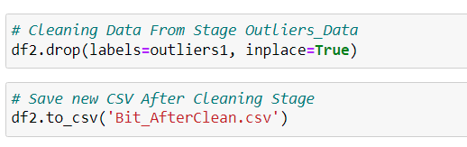
Look For Outliers
Drop Outliers From Set

Slide 21
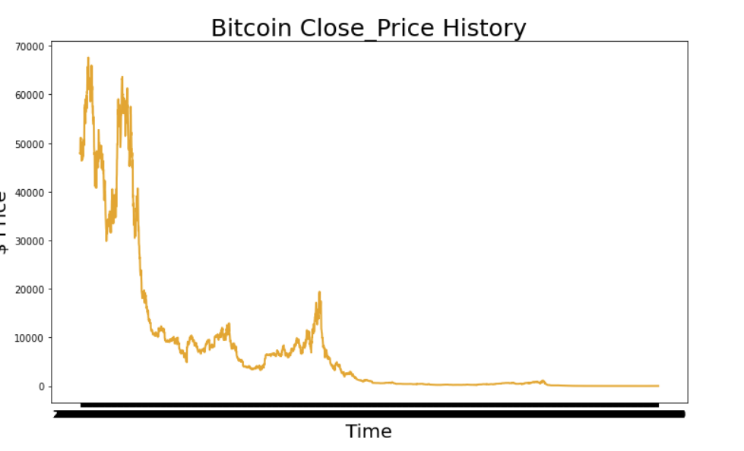
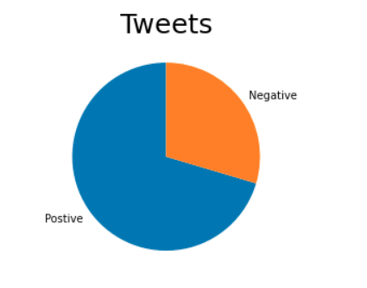
Visualization Stage

Slide 22
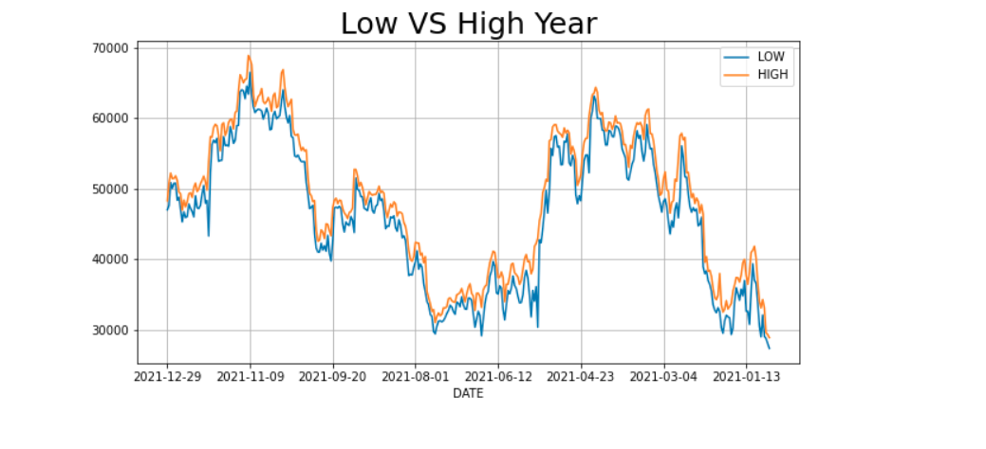

Slide 23
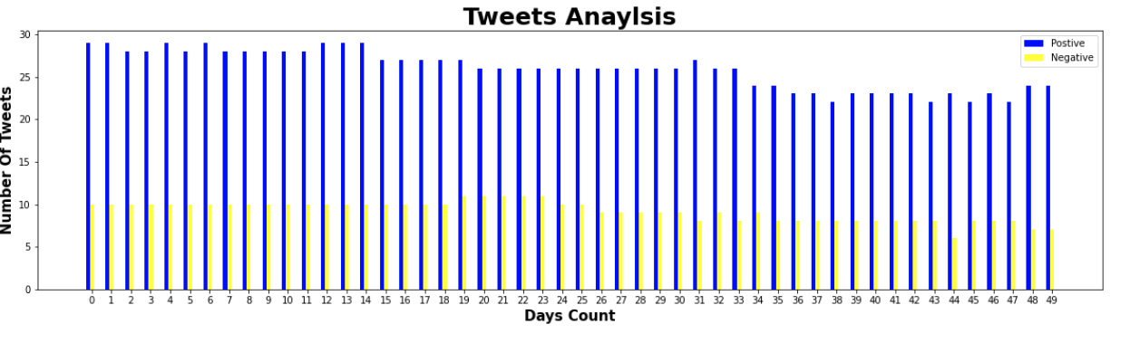
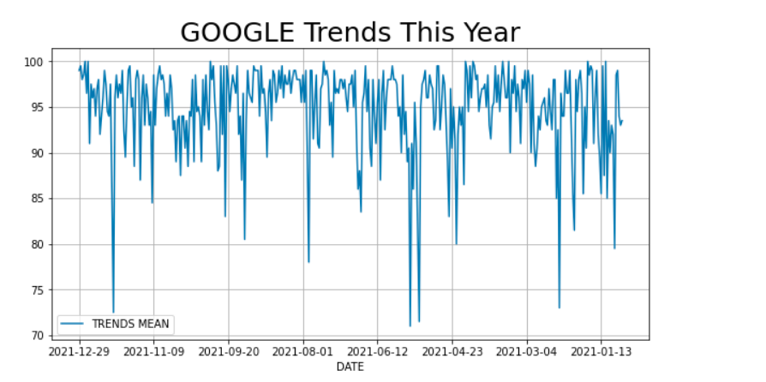
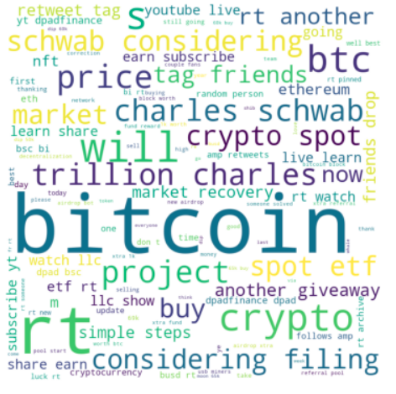

Slide 24
Linear Regression Model
Linear_regression is a linear approach for modelling the relationship between a one or more explanatory variables.
In linear regression we draw the linear line through the data points, then we project a vertical projection of the data points on the regression line to find the minimum distance.
After developing such a model, if additional values of the explanatory variables are collected without an accompanying response value, the fitted model can be used to make a prediction of the response.

Slide 25
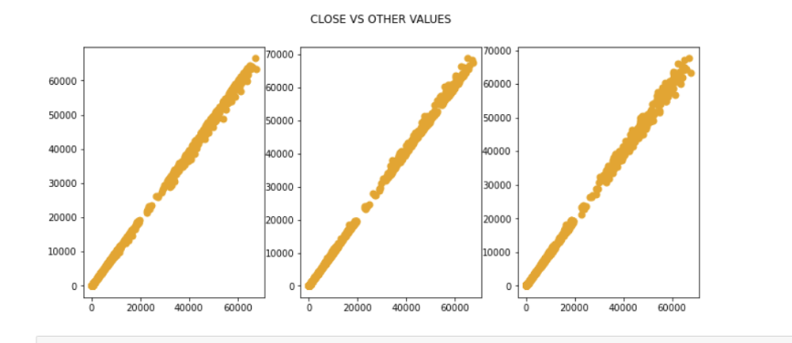
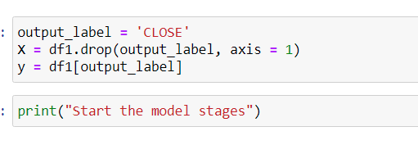
Why Linear Regression ?
We decided to use linear regression model because we saw a clear linear connection between most of the parameters to “CLOSE” column.
Prepare X , y
LOW
HIGH
OPEN

Slide 26
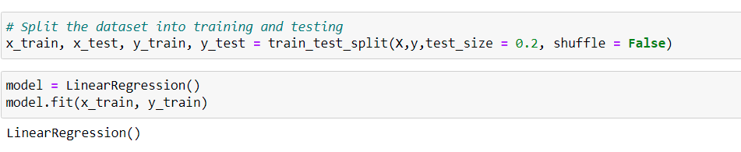
Splitting X,y To Train / Test Sets
Fit The Model To The Sets
Model Score Evaluation

Slide 27
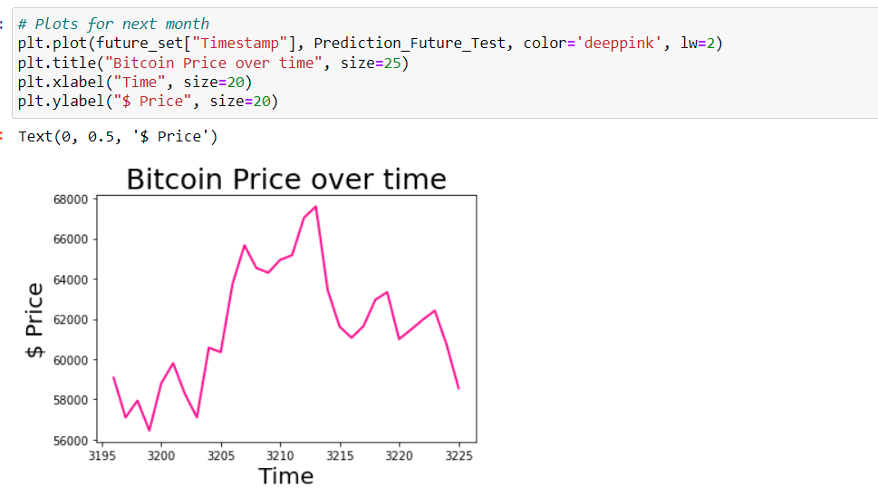
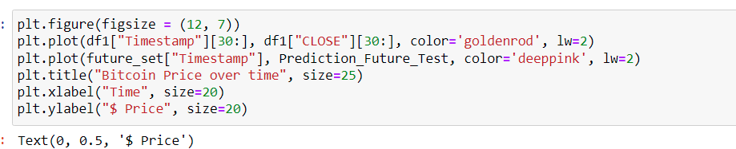
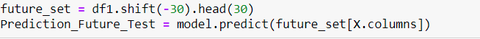
We can the linear regression model brings us very high results for our dataset.
We think we might received “overfitting” using this type of model.
Let’s see what the model predict in 30 days:

Slide 28
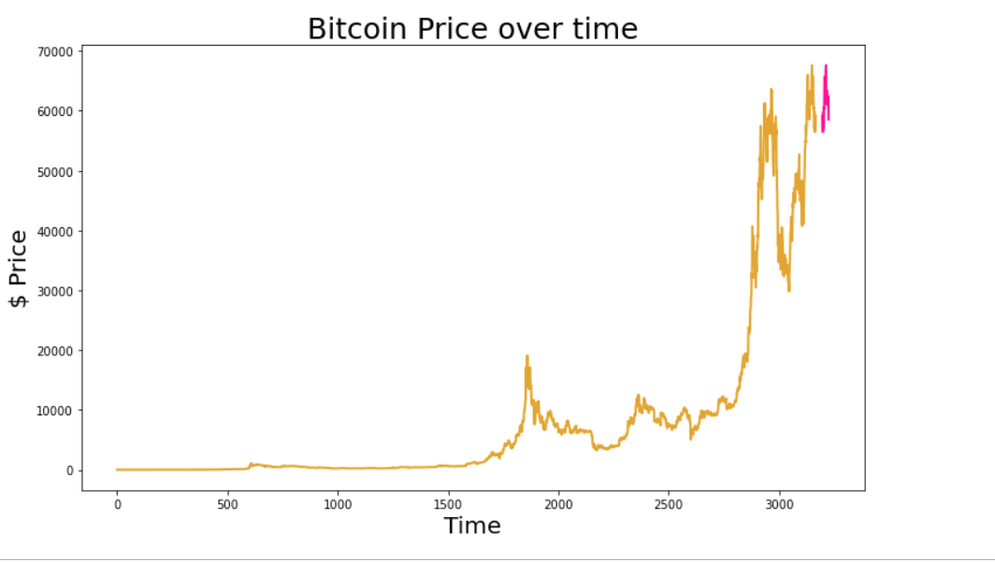
Linear Regression Model Prediction

Slide 29
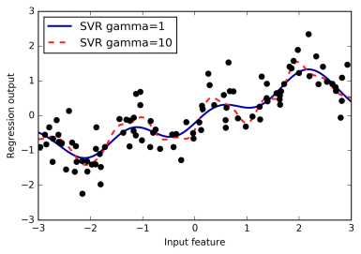
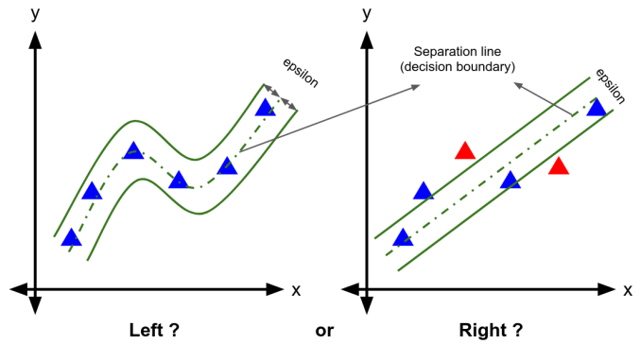
SVR Model
We can import SVR library from sklearn.svm.
Support Vector regression is a type of support vector machine that supports linear and non-linear regression. The mission is to fit as many instances as possible between the lines while limiting the margin violations. The violation represents as ε (epsilon).
The goal in linear regression is to minimize the error between the prediction and data. In SVR, the goal is to make sure that the errors do not exceed the threshold.

Slide 30
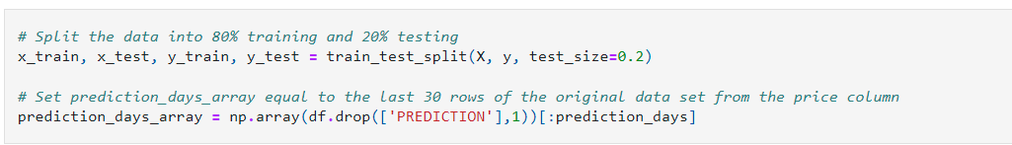
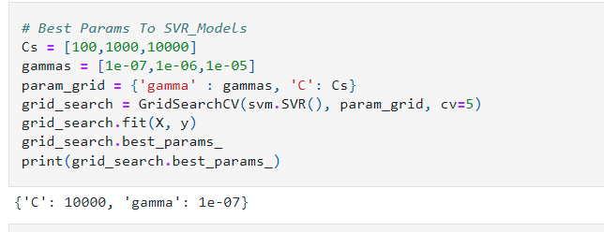
Prepare X , y
Choose The Best Parameters For The Model
Gamma parameter defines how far the influence of a single training example reaches, with low values meaning 'far' and high values meaning 'close'.
Epsilon It specifies the epsilon-tube within which no penalty is associated in the training loss function with points predicted within a distance epsilon from the actual value.

Slide 31
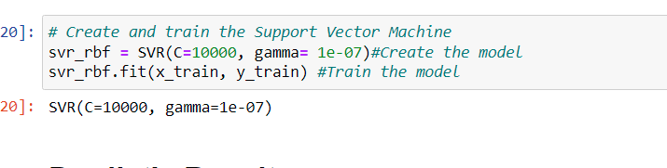
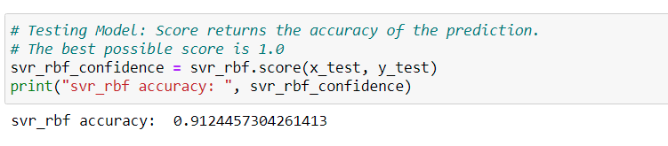
Create The Model With The Selected Prams
Fit The Model In The Sets
Model Score Evaluation

Slide 32
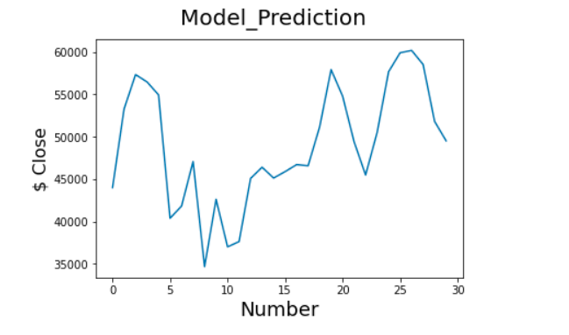
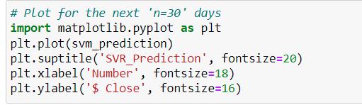
We can the Supported vector model brings also very high results for our dataset.
Our data has linear connection so this model clearly will be less accurate the linear model.
Let’s see what the model predict in 30 days:

Slide 33
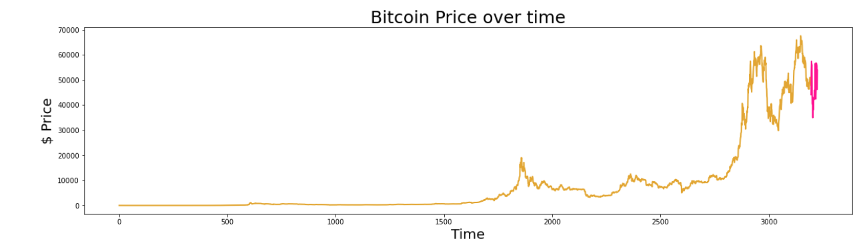
Supported Vectors Model Prediction

Slide 34
Conclusions
We were successful to a good extent in predicting Bitcoin closing prices.
We tried to predict Bitcoin closing price in 30 days using 2 models of regressions: linear_ regression and SVR.
It is important to note that in out prediction we relied on history repeating itself. That not always going to work history might not repeat itself. Also, many factors affecting Bitcoin’s price can come into play.

